Slide 1
JAVASCRIPT FETCH API
Mr. Anbuselvan Annamalai
www.anbuselvan-annamalai.com
PART OF MODERN JAVASCRIPT SERIES

Slide 2
Drawbacks of XMLHttpRequest
Complex syntax - XMLHttpRequest requires multiple steps and event handlers for basic operations.
Callback-based - Leads to "callback hell" with nested callbacks for complex operations
No built-in promise support - Makes error handling and chaining requests cumbersome
Verbose error handling - Requires separate event handlers for different error types
Lacks modern features - No built-in JSON parsing, URL handling, or stream support

Slide 3
Introduction to Fetch API
Modern replacement for XMLHttpRequest
Built on Promises
Native to modern browsers
Part of the JavaScript standard

Slide 4
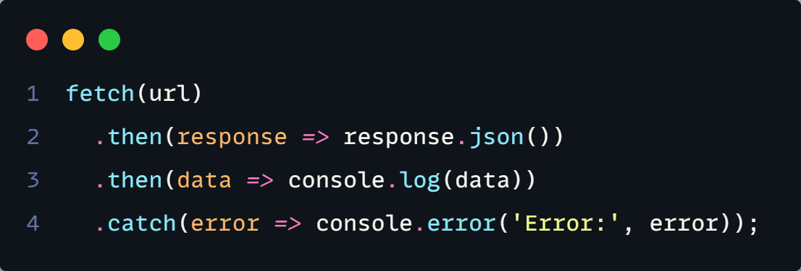
Basic Fetch Structure

Slide 5

Why Use Fetch API Instead
Promise-based architecture
Cleaner code with better error handling
Simplified syntax More concise and readable code
Built-in streaming - Support for handling large data efficiently
Better separation of concerns
Request and Response objects are well-defined
Header manipulation
More intuitive interface for working with headers
Cross-origin support
Better handling of CORS with credentials

Slide 6
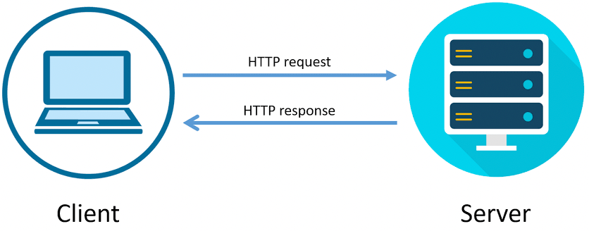
How network resources works?

Slide 7
Request Object
The Request object represents an HTTP request.
Key properties and methods:
method: HTTP method (GET, POST, PUT, DELETE, etc.)
headers: Request headers
body: Request body
mode: CORS mode (cors, no-cors, same-origin)
credentials: How cookies are handled (omit, same-origin, include)
cache: Cache mode
redirect: How redirects are handled

Slide 8
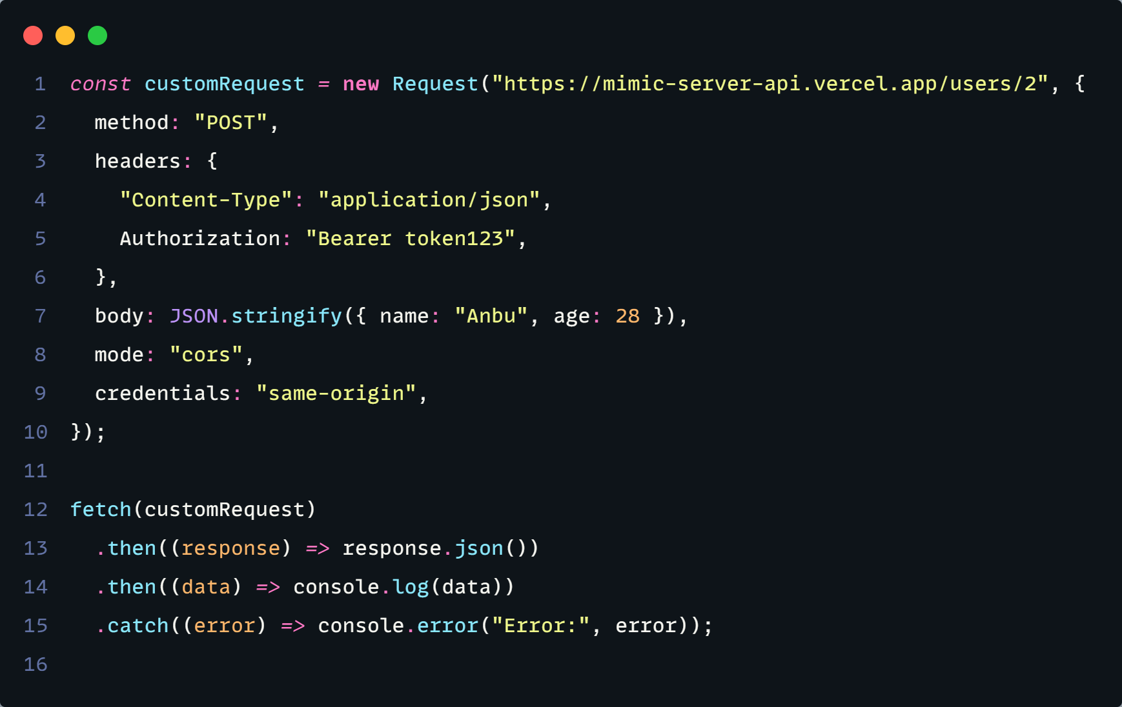

Slide 9
Response Object
The Response object represents an HTTP response.
Key properties and methods:
status: HTTP status code
statusText: HTTP status message
ok: Boolean for successful responses (status 200-299)
headers: Response headers
type: Response type (basic, cors, error)
url: URL of the response
body: ReadableStream of the body content
json(): Parse body as JSON
text(): Parse body as text
blob(): Parse body as Blob
formData(): Parse body as FormData
arrayBuffer(): Parse body as ArrayBuffer

Slide 10
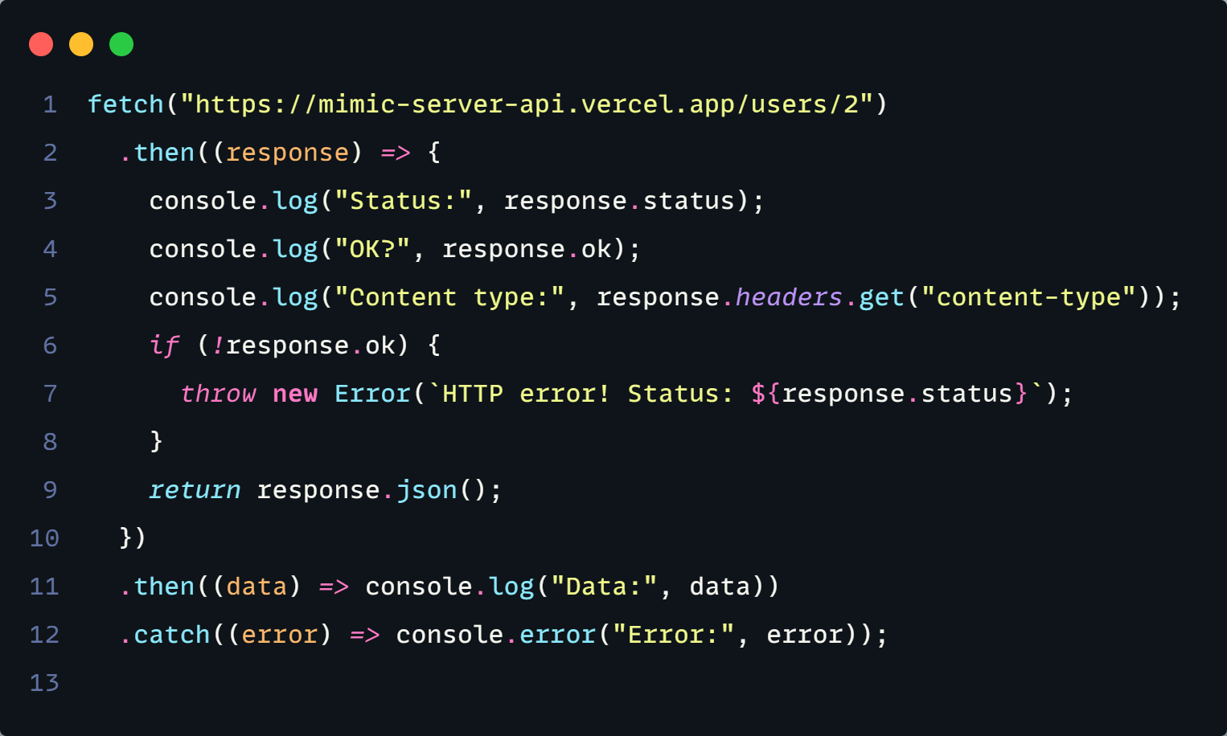

Slide 11
What we gonna learn?
What is Fetch API (Promises & async/await)?
Request vs Response Object
Learn about HTTP methods and status codes
Header Manipulation
CRUD operations using fetch api
Create – Create a new resource
Read – Read a resource
Update – Update a existing resource
Delete – Delete a existing resource
JSON Data processing
Proper error handling
Advanced features (request cancellation)

Slide 12

Fetch Methods
GET:
Retrieve data from a specified URL.
POST:
Send data to a server.
PUT:
Update existing data.
DELETE:
Delete data.
PATCH:
Partially update existing data.

Slide 13
Methods Overview
Each method serves a distinct purpose, helping developers perform essential operations with APIs.
METHOD | DESCRIPTION | USAGE
GET | Retrieve data from a server | fetch('https://api.example.com/data')
POST | Send data to a server | fetch('https://api.example.com/data', { method: 'POST', body: JSON.stringify(data) })
PUT | Update existing data | fetch('https://api.example.com/data/1', { method: 'PUT', body: JSON.stringify(data) })
DELETE | Remove data from a server | fetch('https://api.example.com/data/1', { method: 'DELETE' })
PATCH | Partially update data | fetch('https://api.example.com/data/1', { method: 'PATCH', body: JSON.stringify(data) })

Slide 14
Properties:
url: The URL of the request.
status: the HTTP status code (e.g., 200, 404, 500).
statusText: the HTTP status message (e.g., "OK", "Not Found").
ok: a boolean indicating whether the response was successful (status in the range 200– 299).
headers: an object representing the response headers.
Methods:
json(): parses the response as JSON.
text(): returns the response as a string.
blob(): returns the response as a Blob object.
arrayBuffer(): returns the response as an ArrayBuffer.
formData(): returns the response as a FormData object.
fetch(“”)

Slide 15

Key differences between XMLHttpRequest and Fetch:
Fetch uses Promises, making it cleaner and more modern
XHR requires manual JSON parsing and error handling
Fetch has built-in error handling with try/catch
Fetch includes response.ok for status checking
XHR uses event handlers while Fetch is Promise-based

